Slide 1


AC Market Analysis Using Flipkart Data
Team Members
Tarun Chouhan
KunsothBabulal
Batch No:487

Slide 2

ABSTRACT
What key factors influence the price of air conditioners across different models on Flipkart?
What factors influence customer ratings and overall satisfaction of air conditioners?
What factors affect the energy usage and efficiency of air conditioners?
Web scraping was used to collect air conditioner data directly from Flipkart for real time and accurate information.
Data cleaning and data manipulation were performed to handle missing values, remove inconsistencies and prepare the dataset for analysis.
Exploratory Data Analysis (EDA) was conducted to analyze patterns and understand relationships between price, ratings and energy usage across different AC brands and models.
These insights help buyers choose better ACs and brands understand market trends.

Slide 3
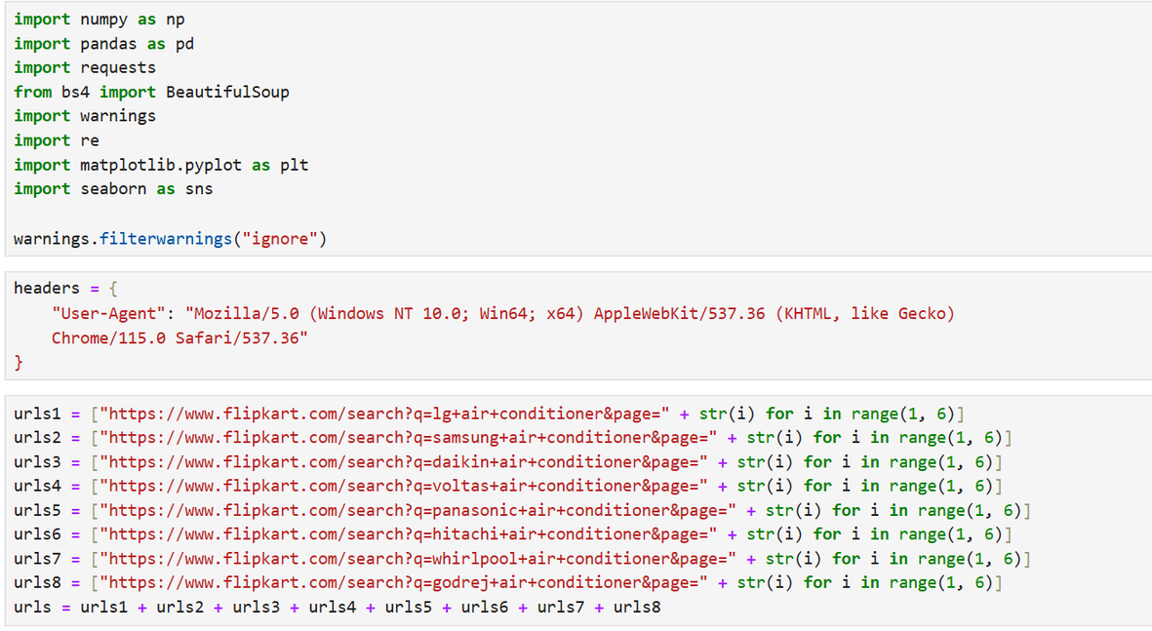
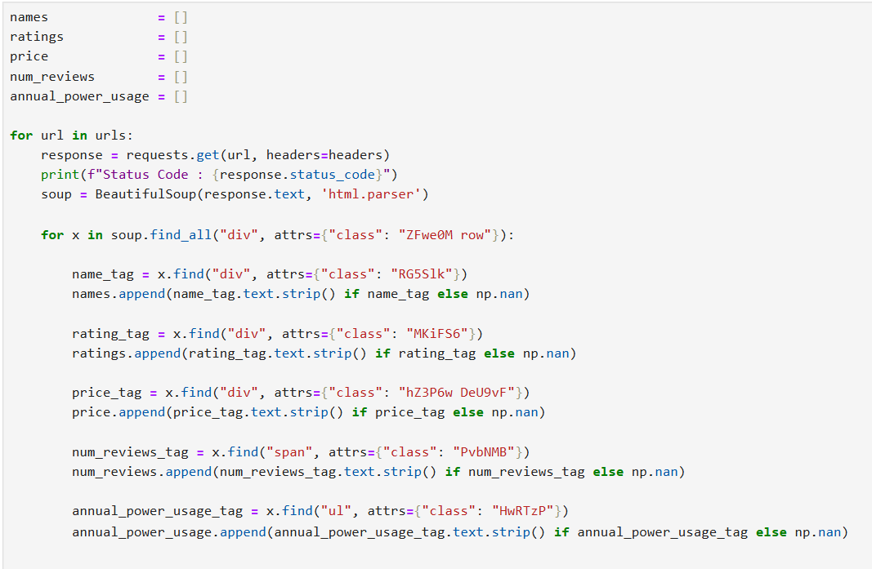
WEB SCRAPING WORKFLOW

Slide 4
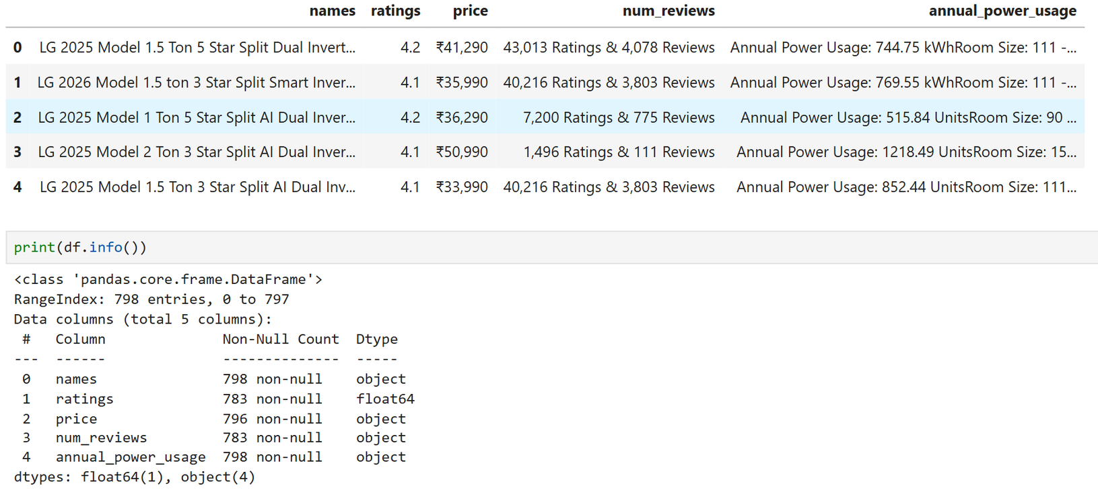
DATASET OVERVIEW

Slide 5
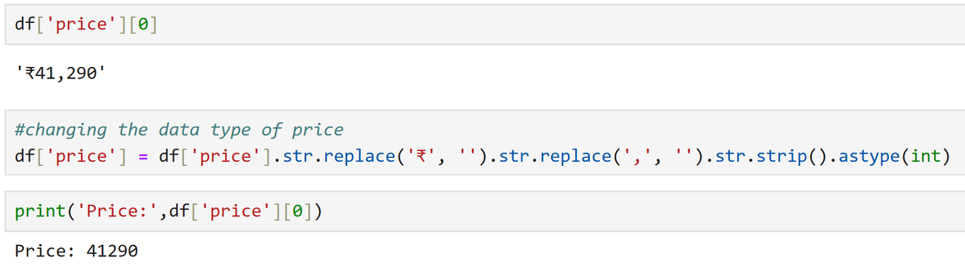
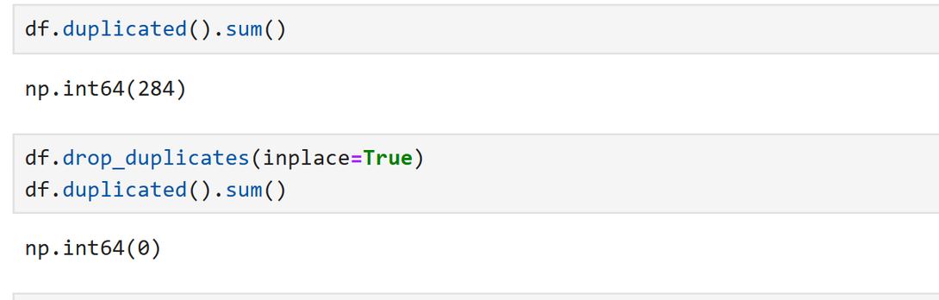
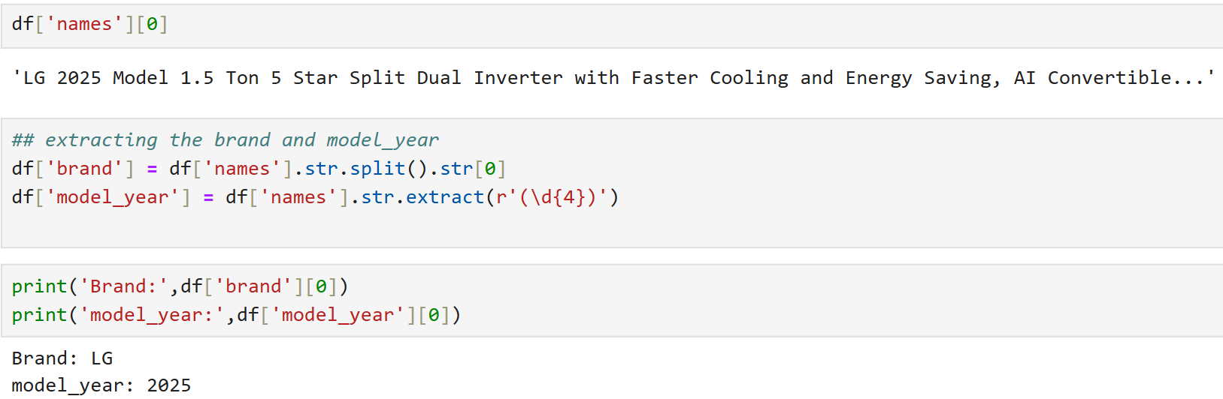
DATA CLEANING & DATA MANIPULATION
Ex 1 – Price Cleaning
Ex 2 – Remove Duplicates
Ex 3 – Extract Brand & Year

Slide 6
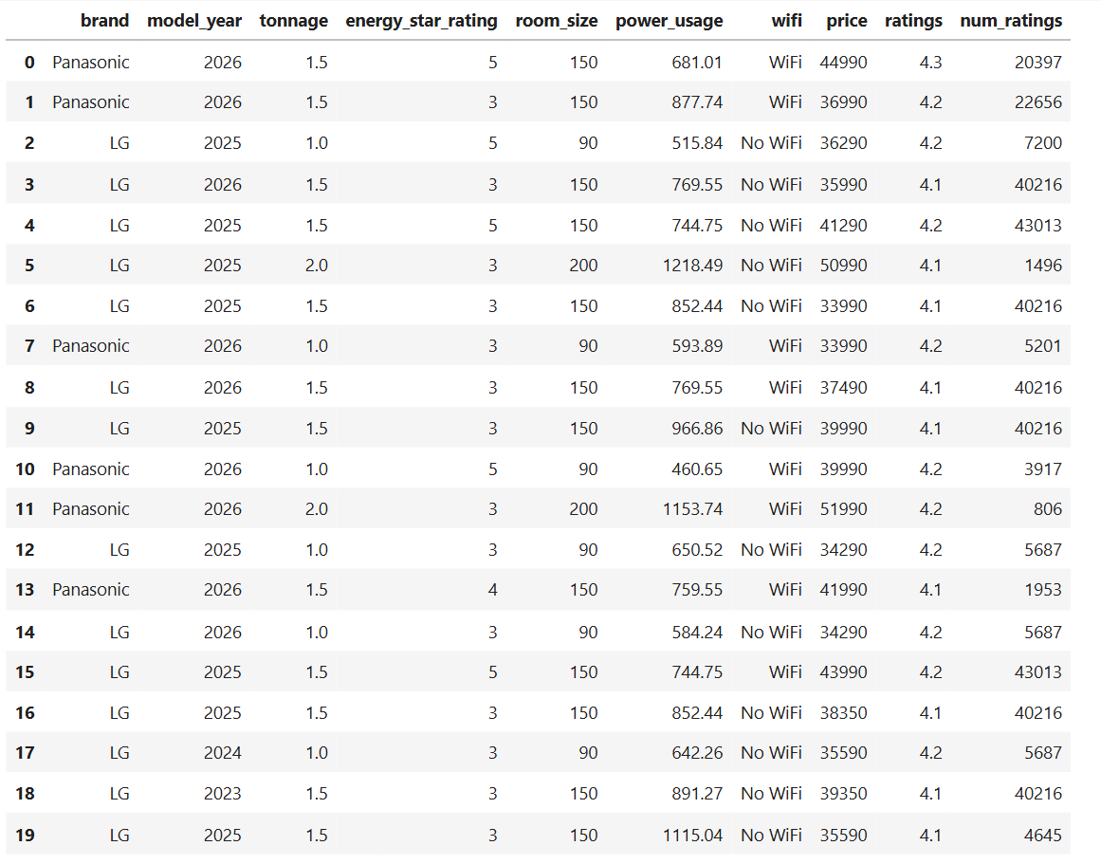
CLEANED AND STRUCTURED DATA

Slide 7
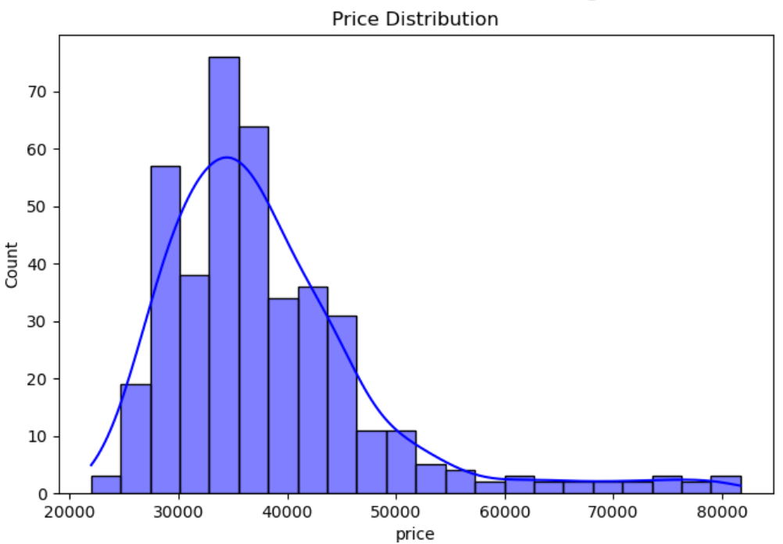
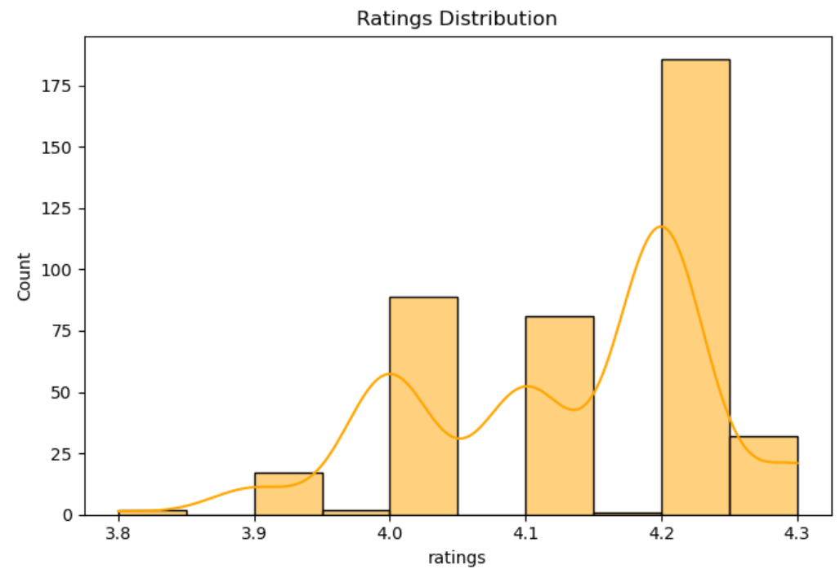
UNIVARIATE ANALYSIS
Observations
Price is right skewed — majority ACs priced ₹28k–₹40k, few luxury outliers above ₹60k
Ratings are left skewed — most ACs rated 4.2, customers are generally satisfied

Slide 8
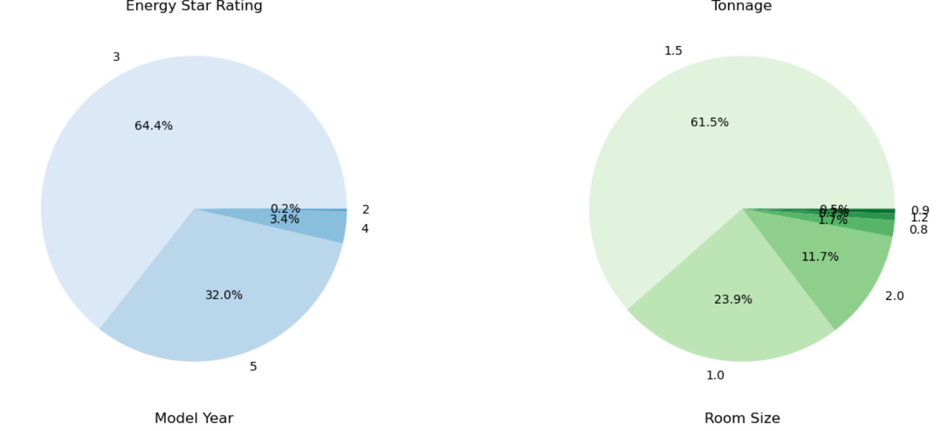
Observations
64.4% ACs are 3-star (budget) vs 32% are 5-star (premium) — clear market split
61.5% ACs are 1.5 ton — standard Indian bedroom size dominates the market

Slide 9
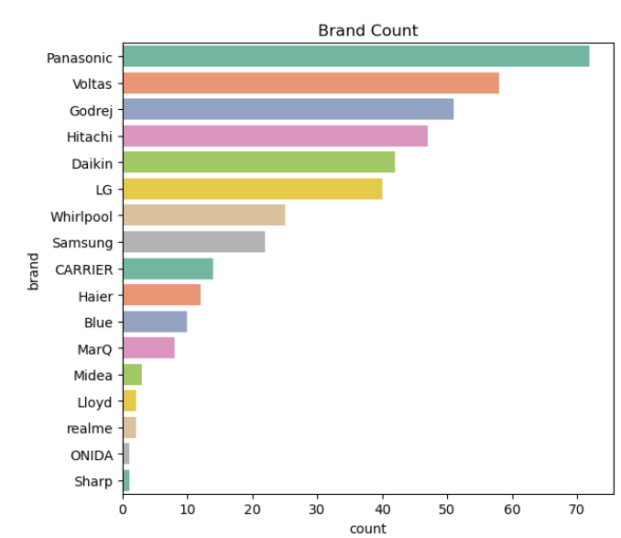
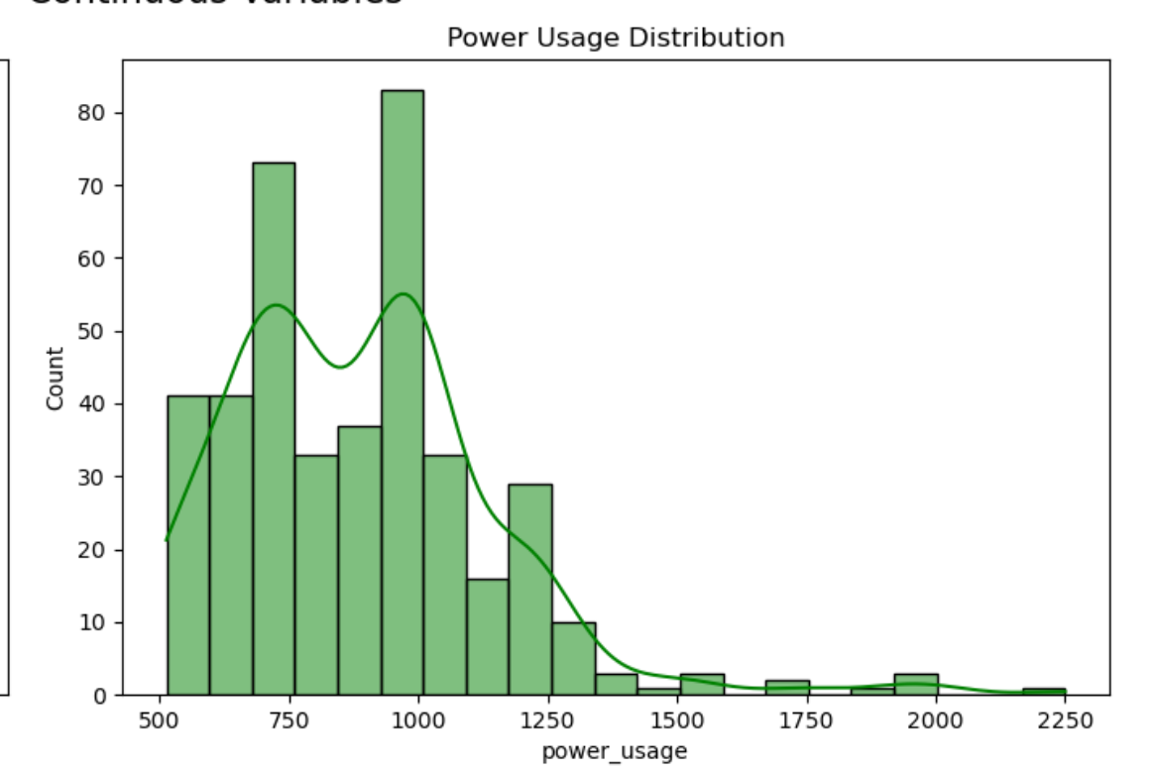
Observations
Panasonic has the most ACs listed (73), followed by Voltas and Godrej
Top 5 brands together make up more than 70% of all ACs on Flipkart
Most ACs use either around 750W or 950W of power
This is because 1-ton ACs use less power and 1.5-ton ACs use more power

Slide 10
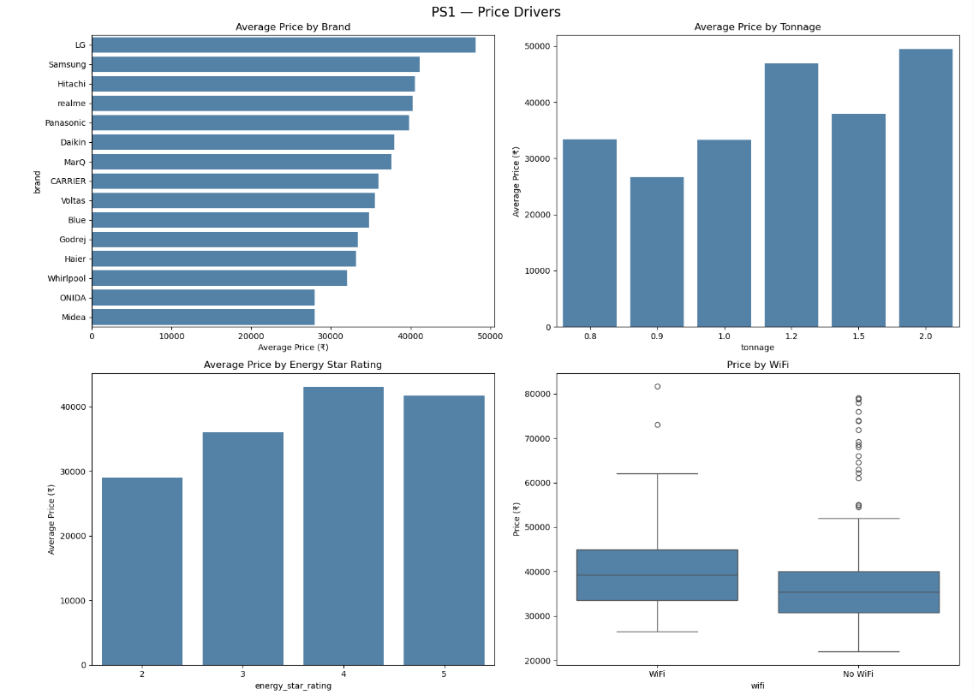
BIVARIATE ANALYSIS
Observation
LG is the most expensive brand, Midea and ONIDA are the cheapest
Bigger tonnage ACs cost more — 2 ton is the most expensive
Higher star rating means higher price — 4 and 5 star ACs cost more
WiFi ACs are around ₹4,000 to ₹5,000 costlier than non WiFi ACs

Slide 11
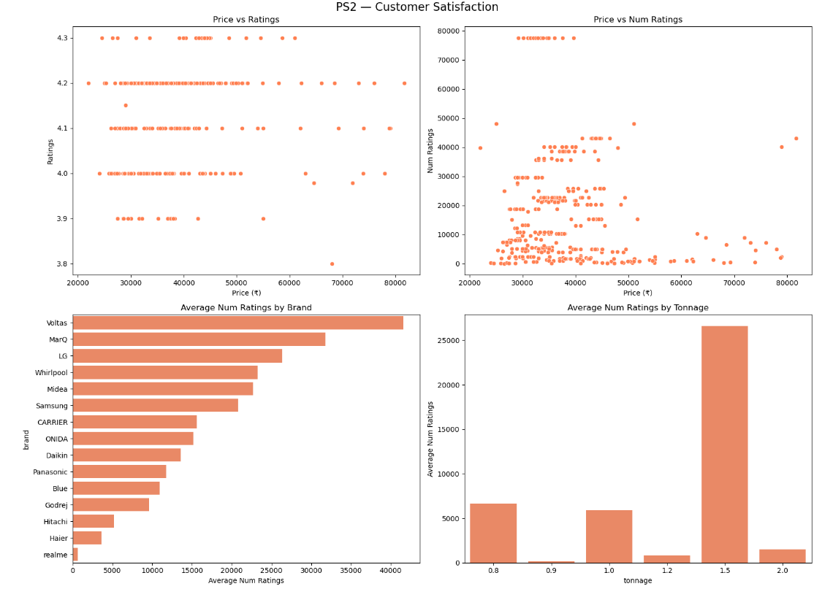
Observation
Price has no clear effect on ratings expensive and cheap ACs are rated similarly
Budget ACs (₹25k–₹35k) get more reviews more people buy affordable ACs
Voltas is the most popular brand with highest number of reviews, realme and Haier least popular
1.5 ton ACs get far more reviews than any other size it's the most purchased capacity

Slide 12
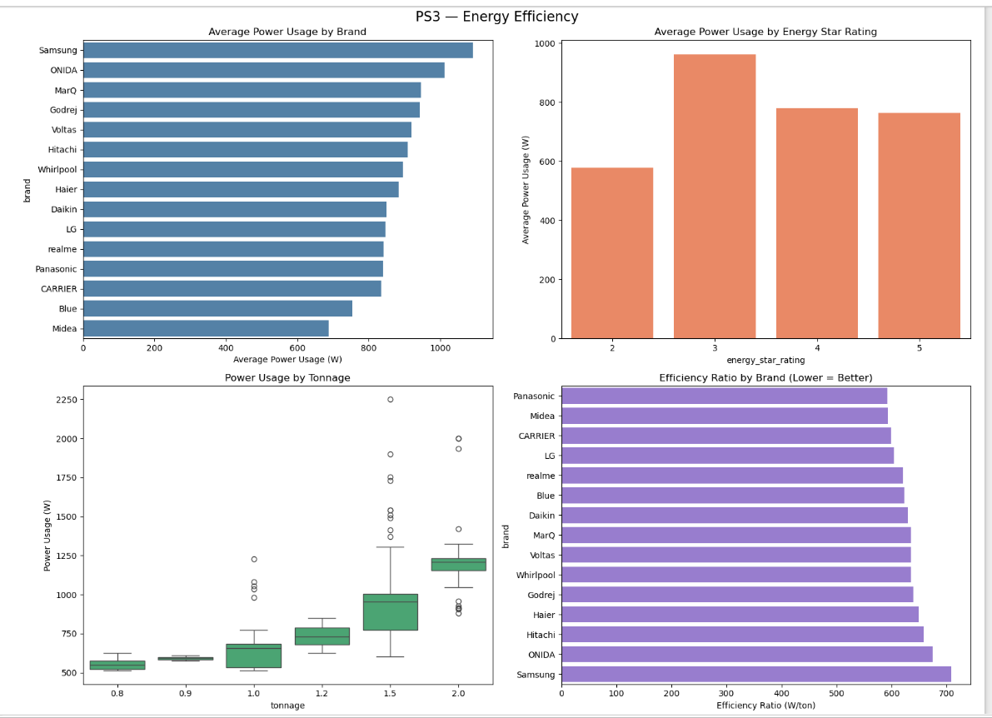
Observation
Samsung uses the most power (1050W), Midea is the most energy efficient brand (650W)
3-star ACs consume the most power (~950W), 5-star ACs consume the least (~750W) — star rating works!
Power usage increases clearly with tonnage — 0.8 ton uses ~550W, 2.0 ton uses ~1200W
Panasonic and Midea have the best efficiency ratio — they give more cooling per watt used

Slide 13
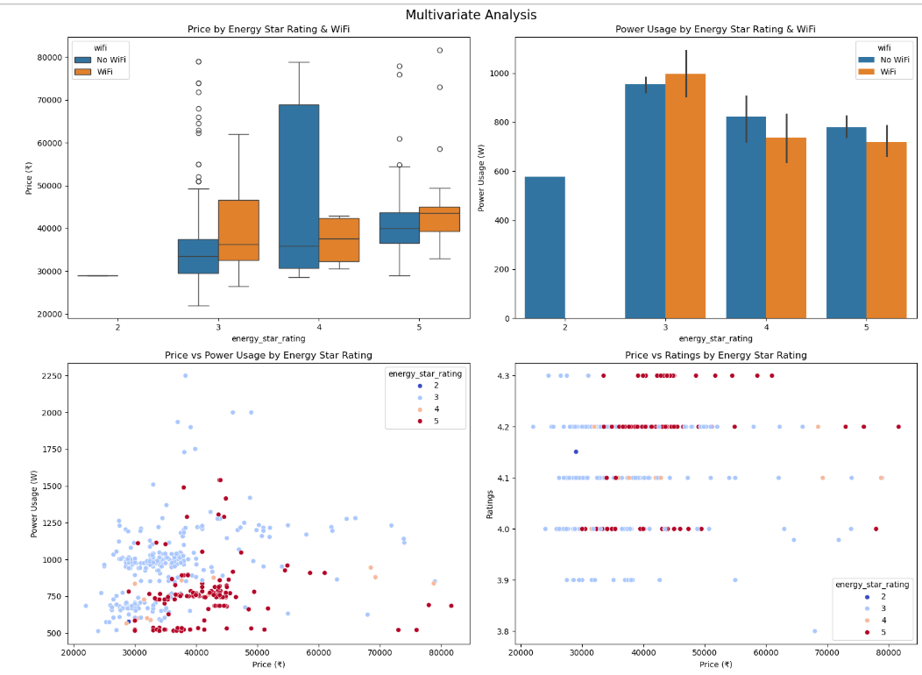
Observation
WiFi ACs are priced higher across all star ratings — 3-star WiFi ACs cost noticeably more than 3-star non WiFi ACs
5-star ACs consume less power regardless of WiFi — both WiFi and non WiFi 5-star ACs are more energy efficient than 3-star
Higher priced ACs tend to use more power — because expensive ACs are usually higher tonnage
Price has no effect on ratings across any star rating — dots are scattered randomly at all price points

Slide 14
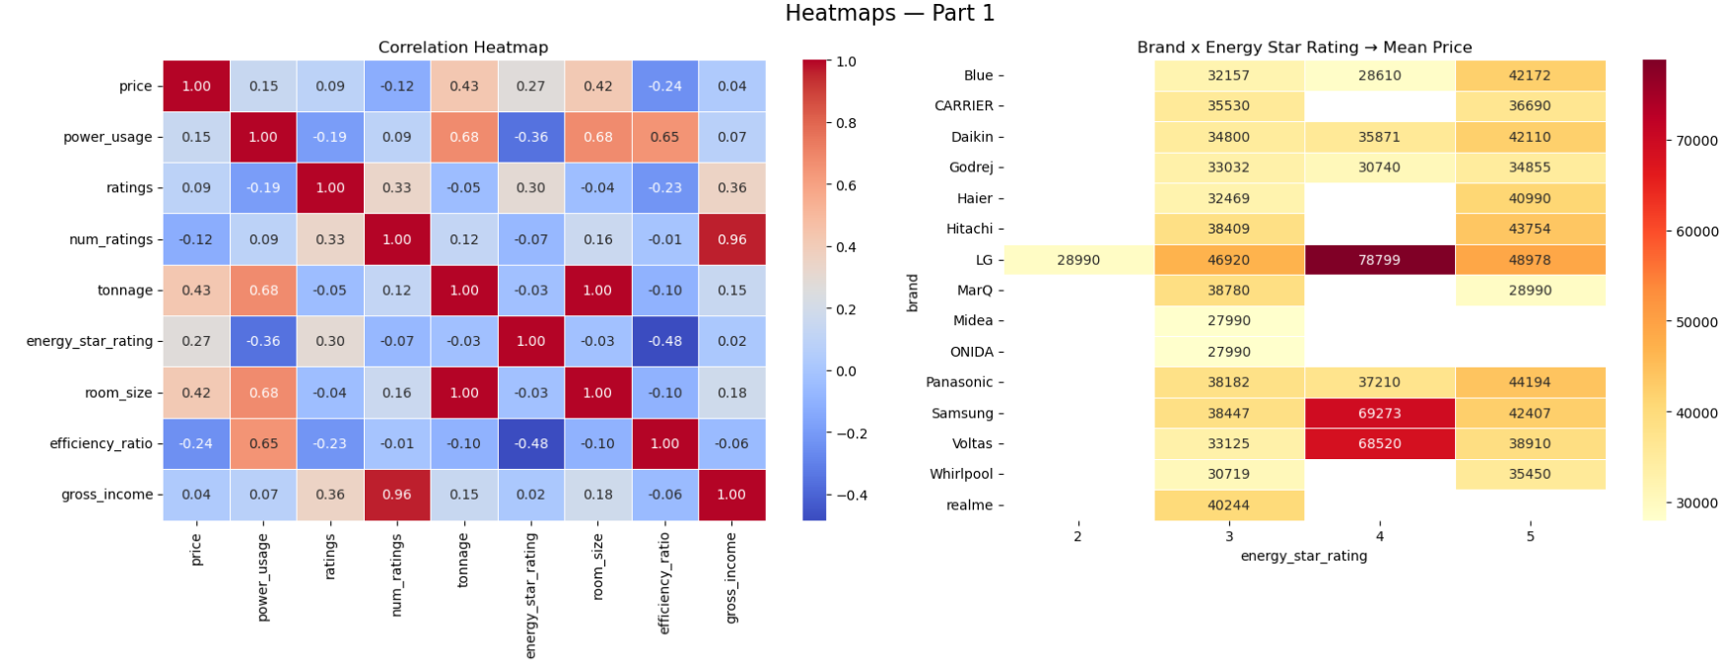
Observation
Power usage increases with tonnage, showing larger ACs consume more electricity.
Price positively correlates with tonnage and room size, meaning bigger ACs cost more.
3-Star ACs dominate across most brands, especially Panasonic, Voltas, and Godrej.

Slide 15
KEY INSIGHTS
LG is the most premium brand, Midea and ONIDA are the most budget friendly
78.5% ACs on Flipkart do not have WiFi — it is still a premium feature
Panasonic has the most listings but Voltas has the most customer reviews
Higher tonnage always means higher price and higher power usage
Price does not affect ratings — cheap and expensive ACs are rated similarly
BUSINESS INSIGHT:
Focus on 1.5 ton 3-star segment, invest in WiFi and 5-star efficiency to attract premium buyers, and keep prices competitive as Indian customers are price sensitive

Slide 16

THANK YOU

